Slide 1
Discovery Science Application for SFI Plaque of STEM 2018/19
Kilcoskan NS

Slide 2
STEP 1 Science
1 hands-on investigation from each of the four curriculum strands :
Living things
Energy and forces
Materials
Environmental awareness and care
AND the following:
Invite a Science speaker to your school
Visit an SFI Discover Centre
Take part in Science Week 2018 www.scienceweek.ie
Take part in Space Week 2018 www.spaceweek.ie

Slide 3
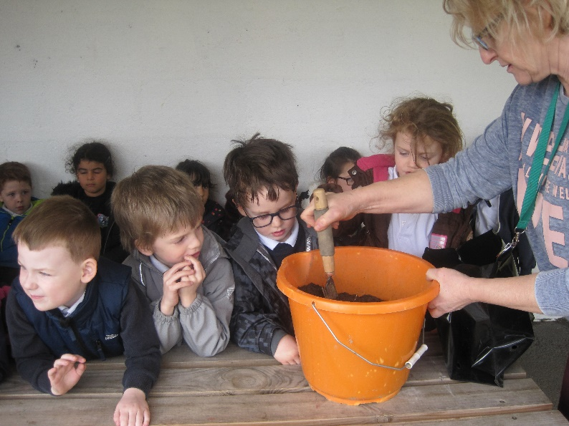
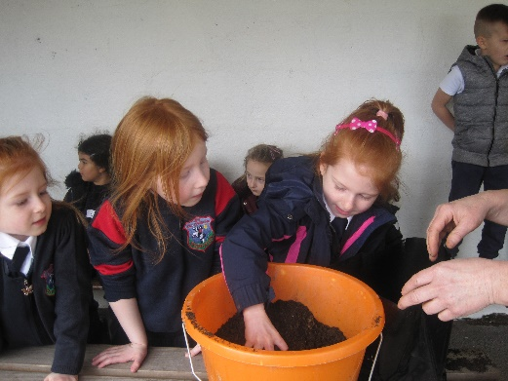
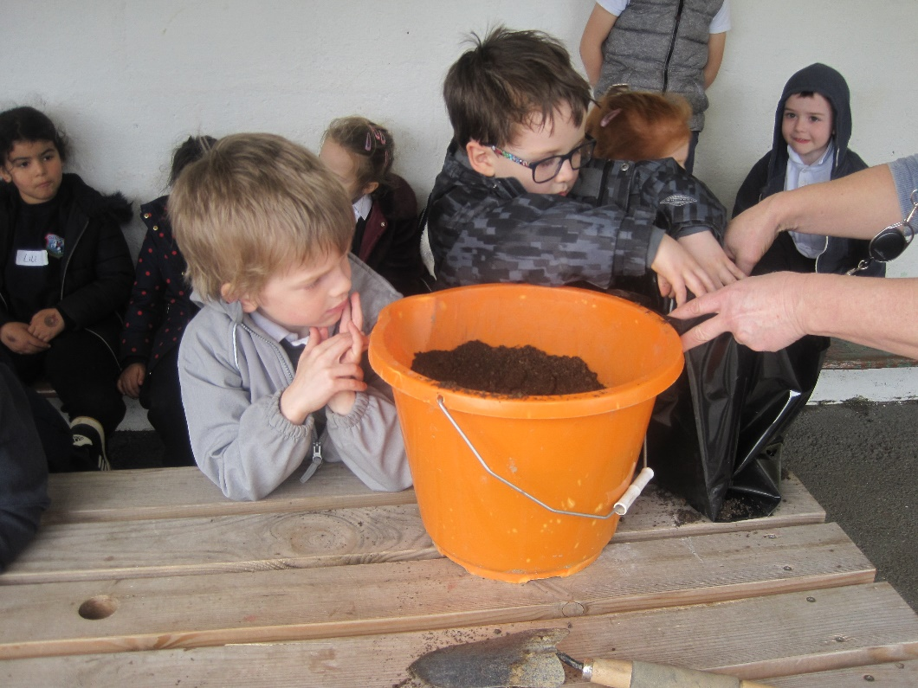
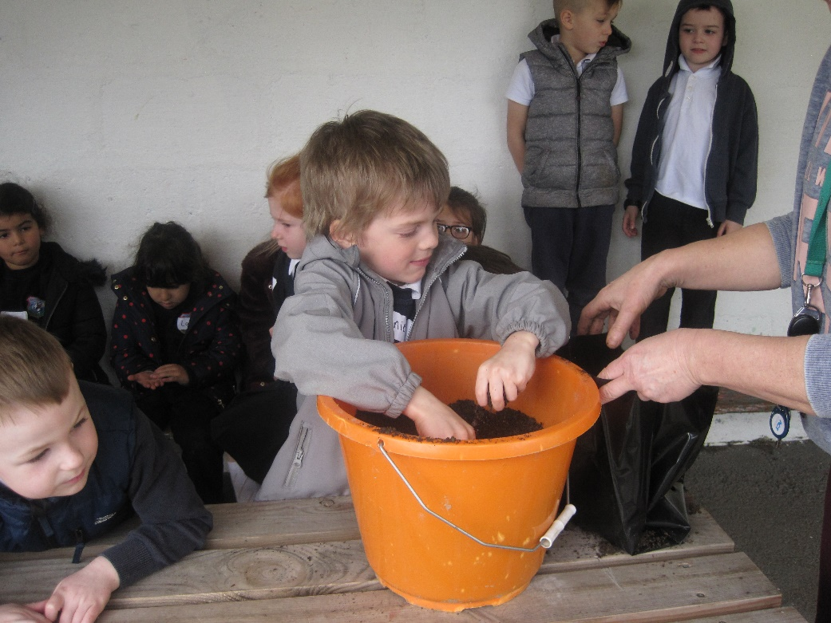
Living things 1
The whole school learned about plant science with their teachers and then planted sunflower seeds (different varieties) with Grainne

Slide 4
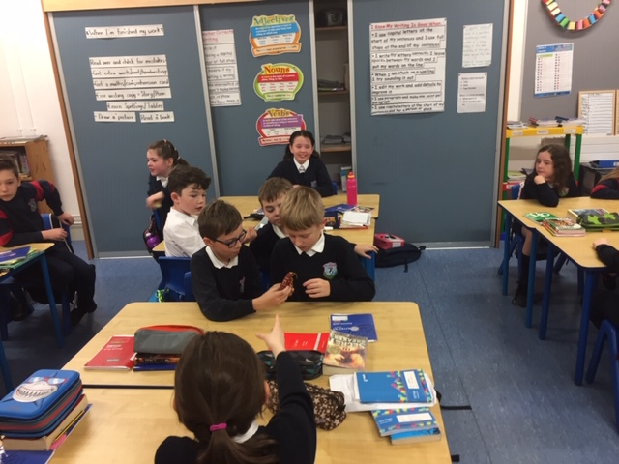
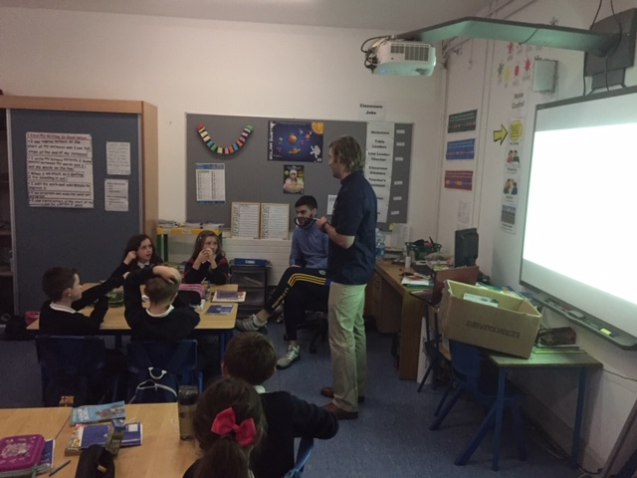
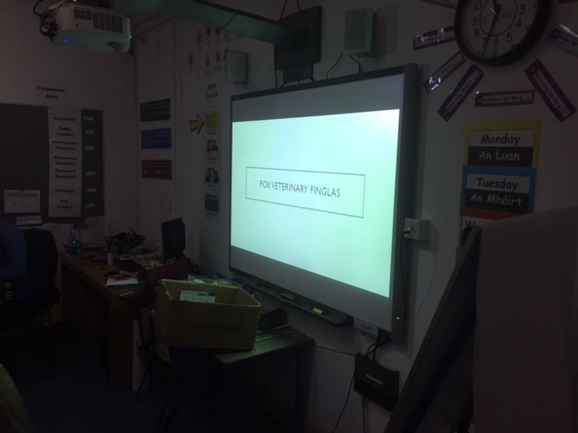
Living things 2
Michael from Fox’s vets in Finglas gave a talk to 3rd-6th about his daily routine in the practice and showed the kids some incredible photos of things he has come across with animals (Monday 15th Nov 2019 )

Slide 5
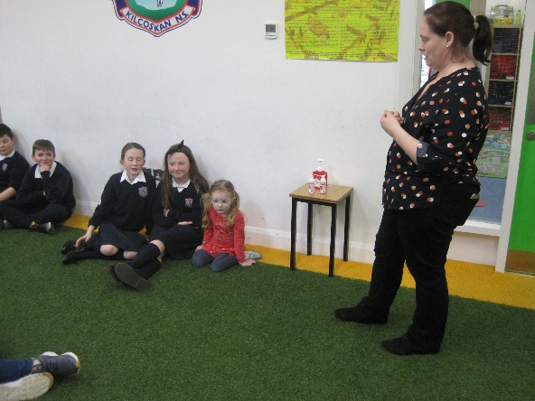
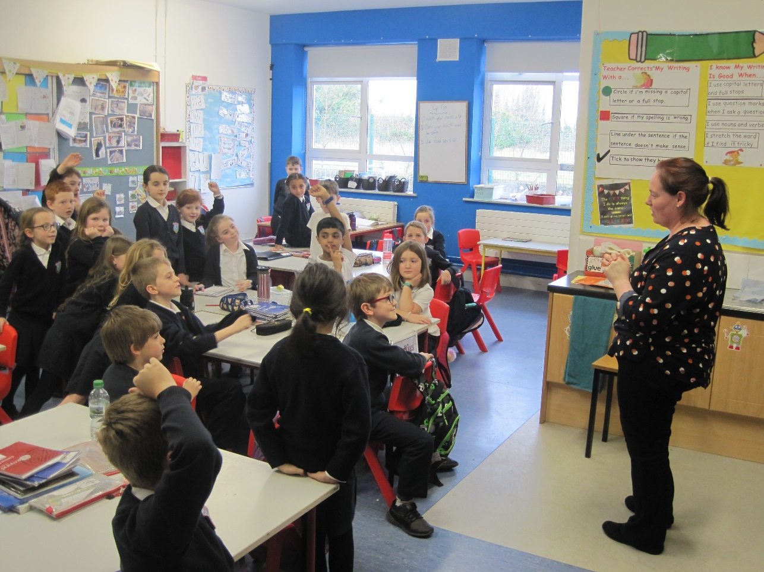
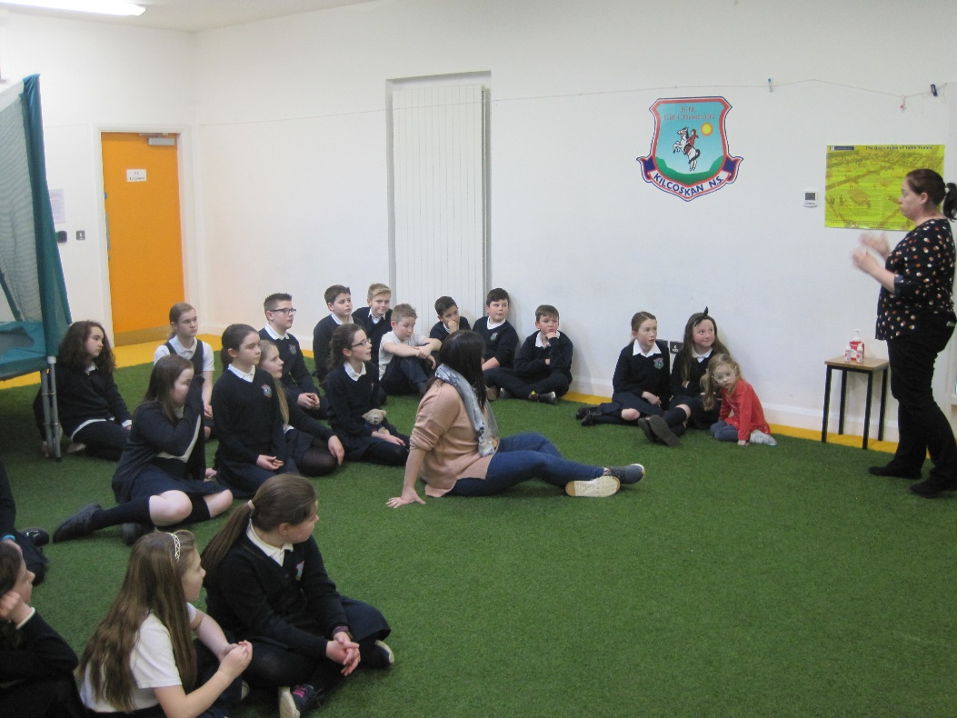
Living things 3
Antoinette Connolly from Temple Street hospital spoke to all the classes in the school about germs and bacteria

Slide 6
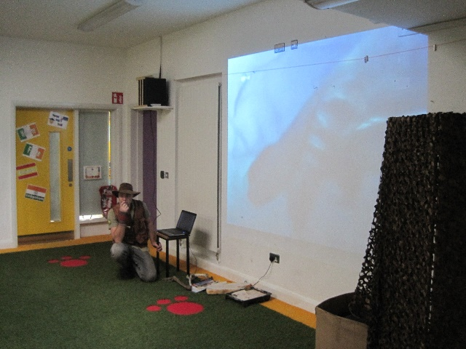
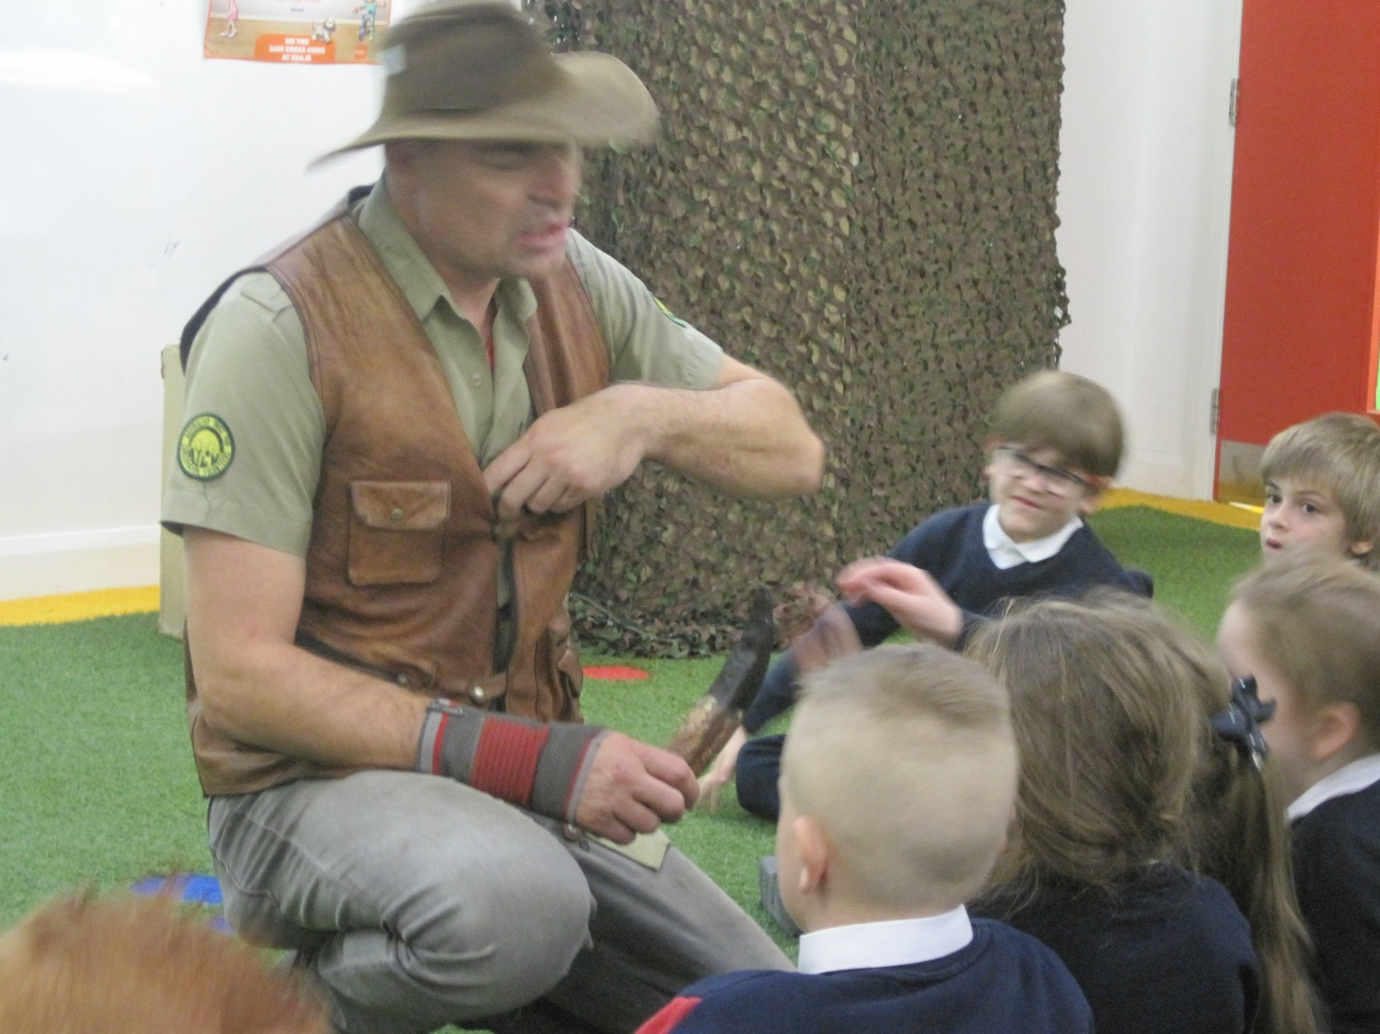
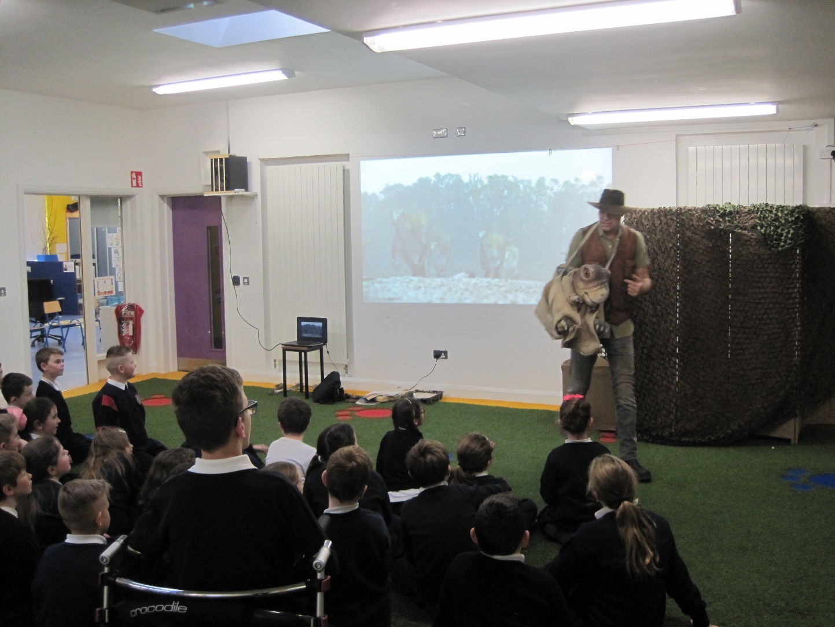
Living things 4
Dale Treadwell came to our school to talk about dinosaurs

Slide 7
Energy and Forces
1st-6th took part in Engineering Week in the school – we used knex Forces and Motion kits . 5th and 6th were the first class to do the lessons (on Potential and Kinetic Energy) with Mr Christie and they acted as assistants to Mr Christie when he did the same lessons with 1st-4th .
3rd and 4th also went to Marsh’s Library in the city centre to do a 10 station engineering challenge !! Wednesday 6th March 2019 12.15pm
https://www.kilcoskanns.ie/news/engineering-challenge-at-marsh-library/

Slide 8
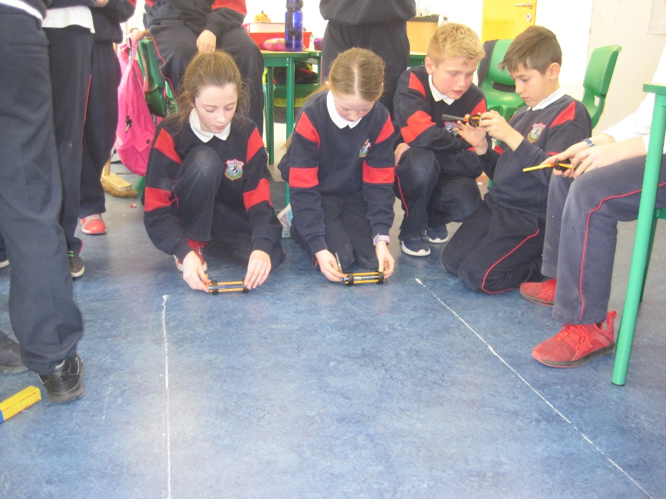
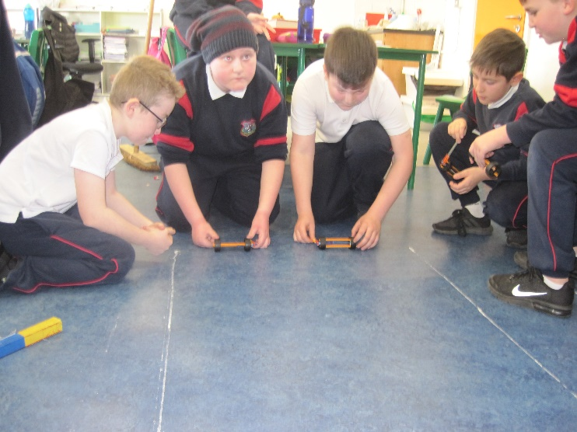
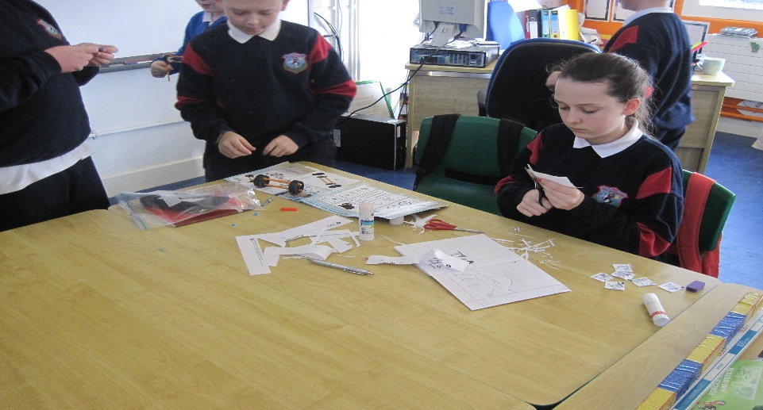
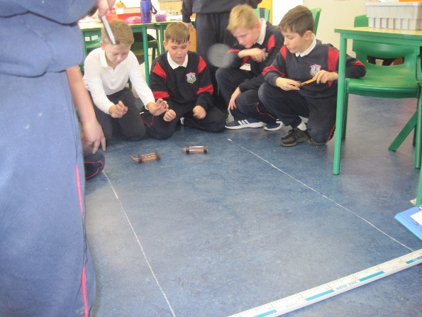
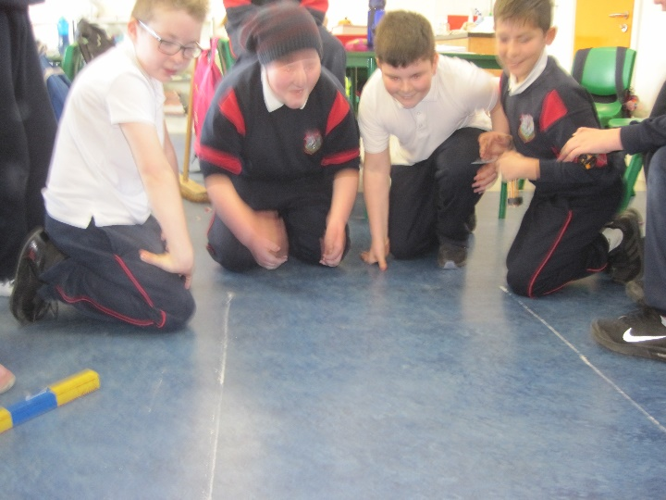
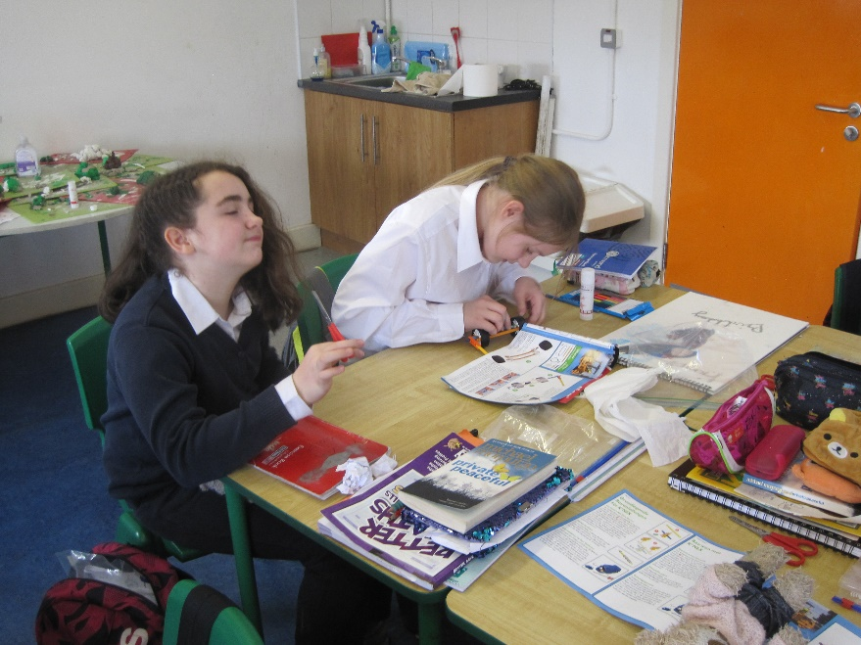
Knex lessons

Slide 9
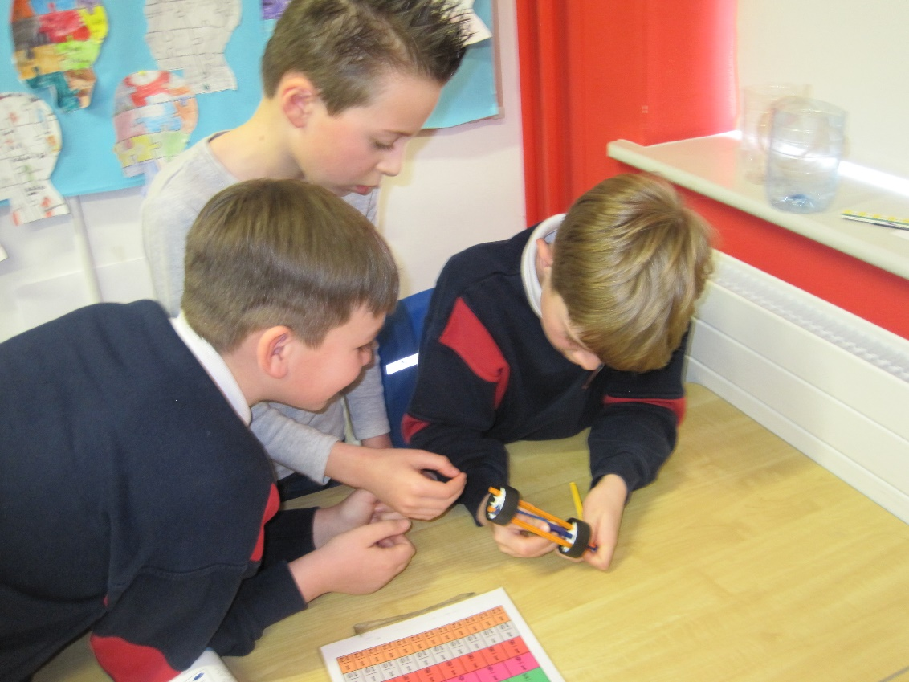
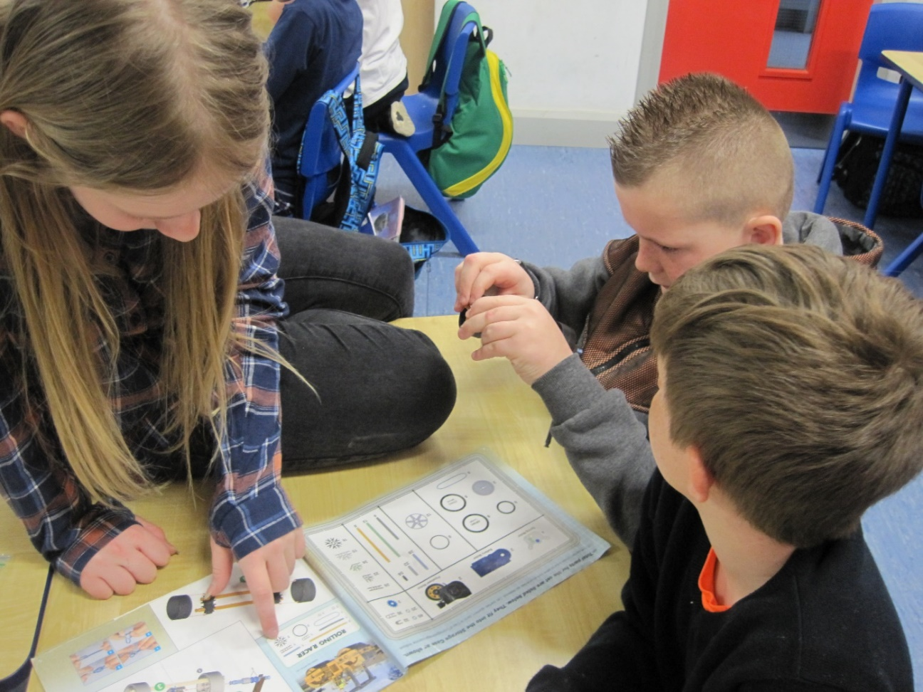
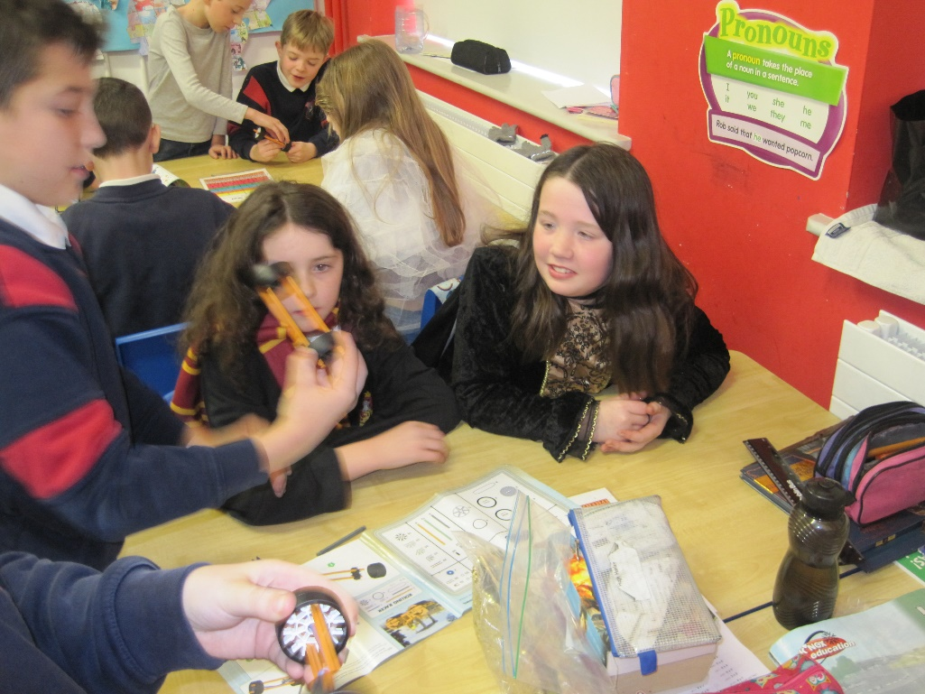
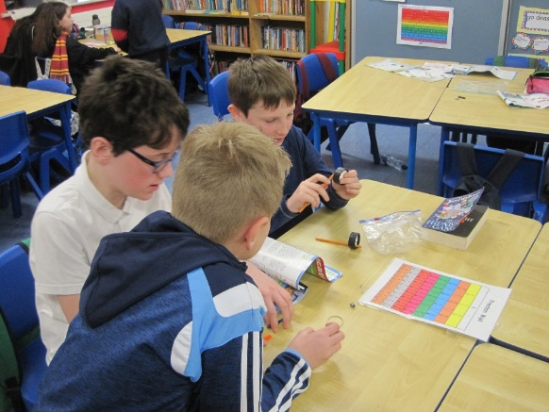

Slide 10
Knex reports 1st/2nd class

Slide 11
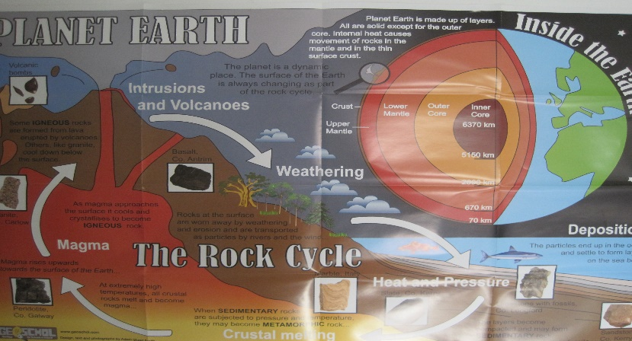
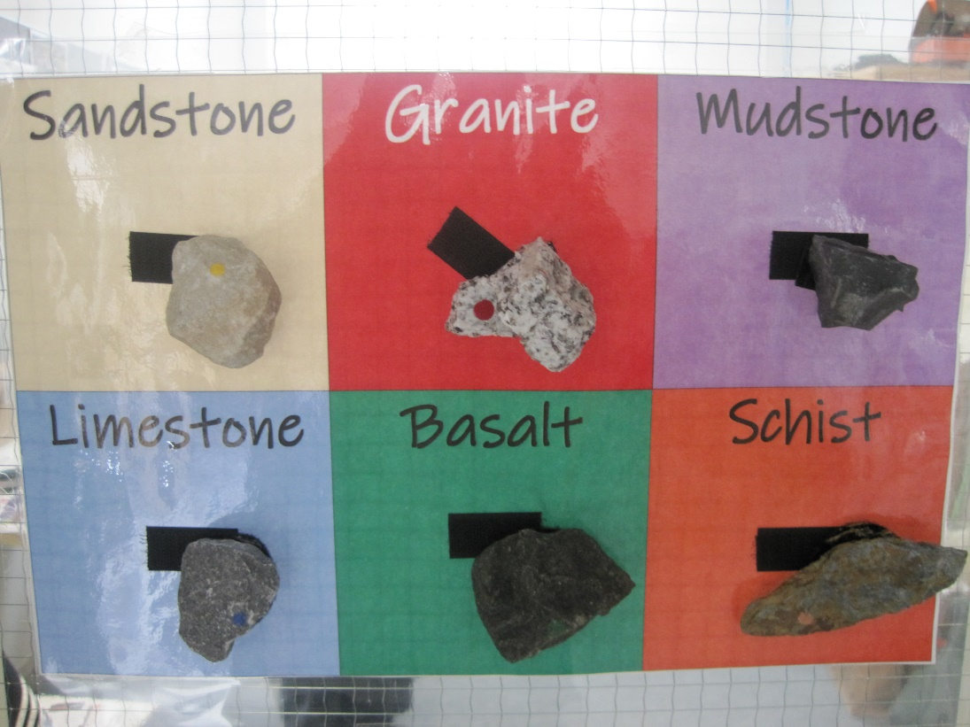
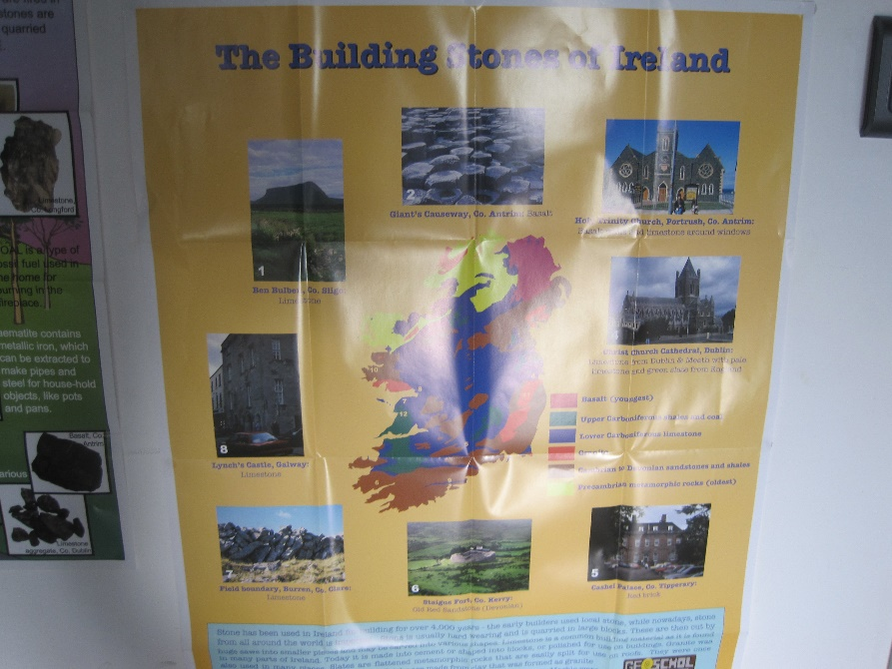
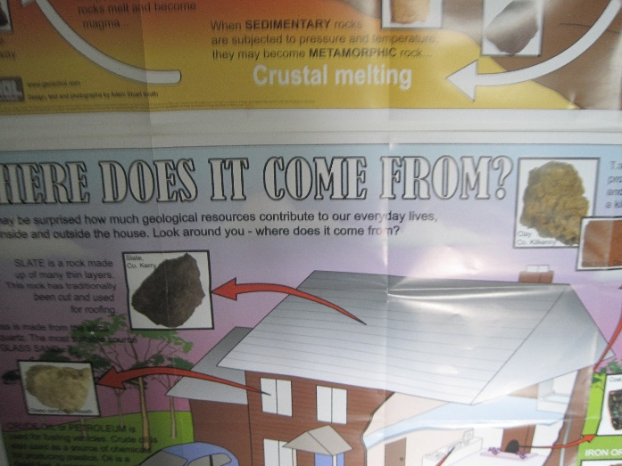
Materials
Our focus for this section was on rocks – the 3 different types and looking at samples of rocks , we also looked around the yard to see what everyday rocks were popular. We spoke about hardness and texture .

Slide 12
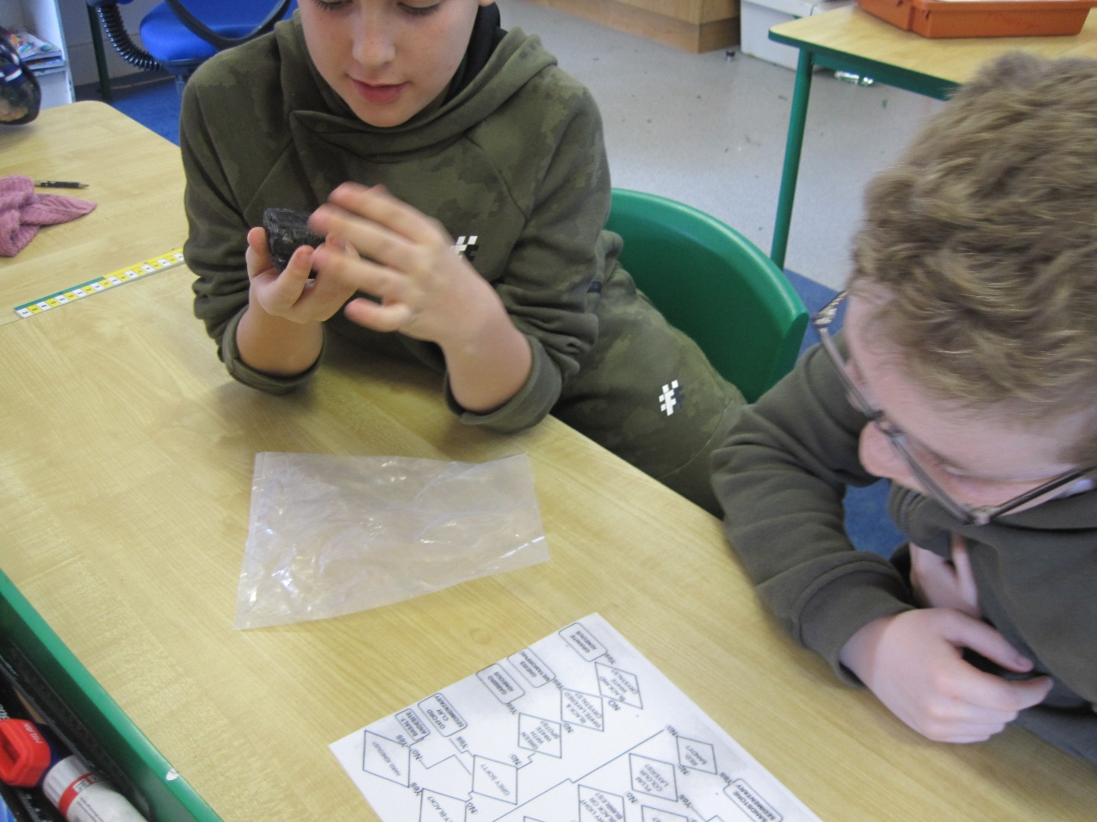
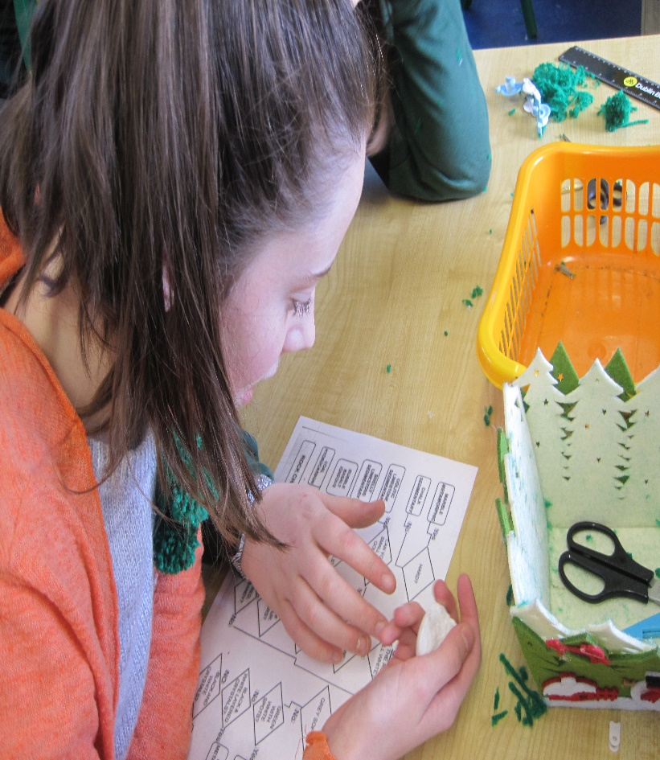
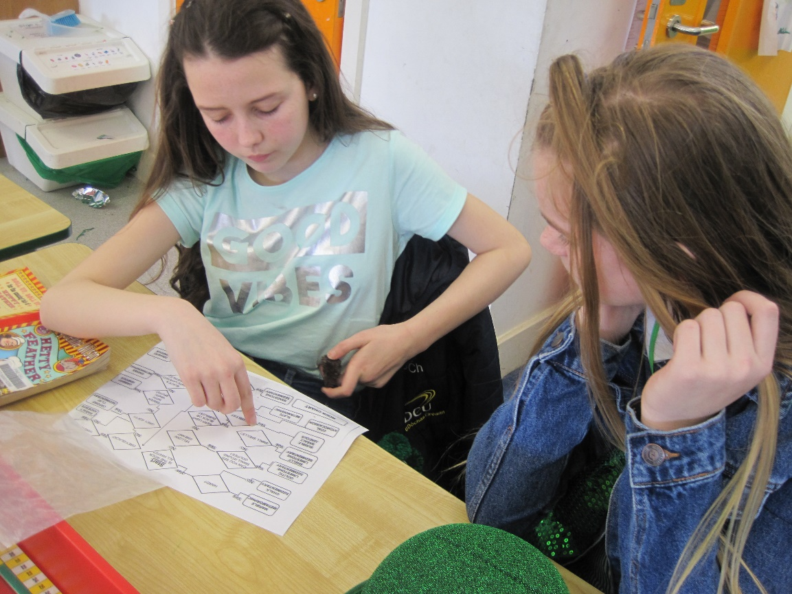
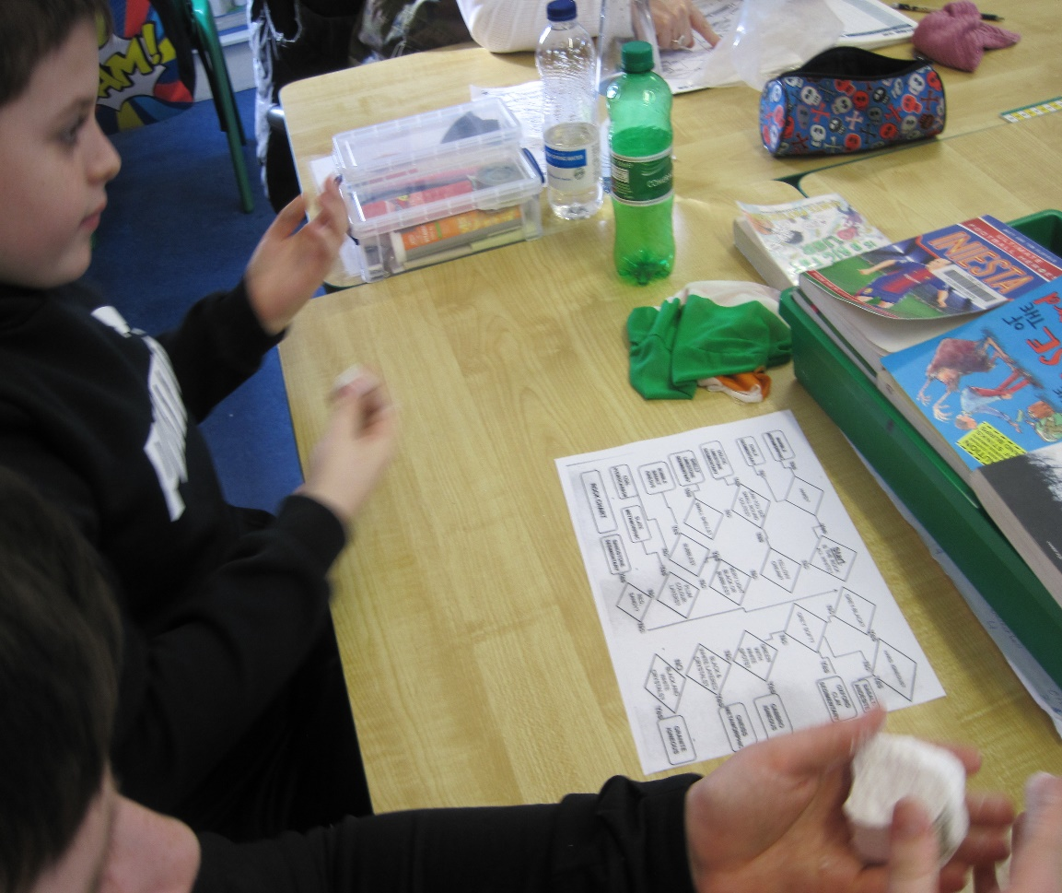
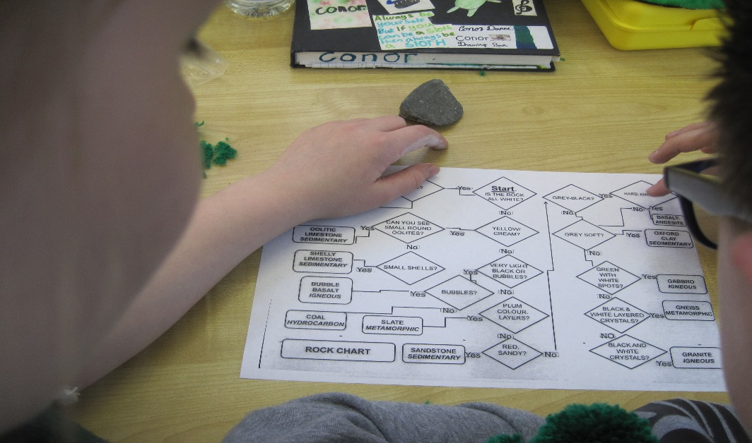

Slide 13
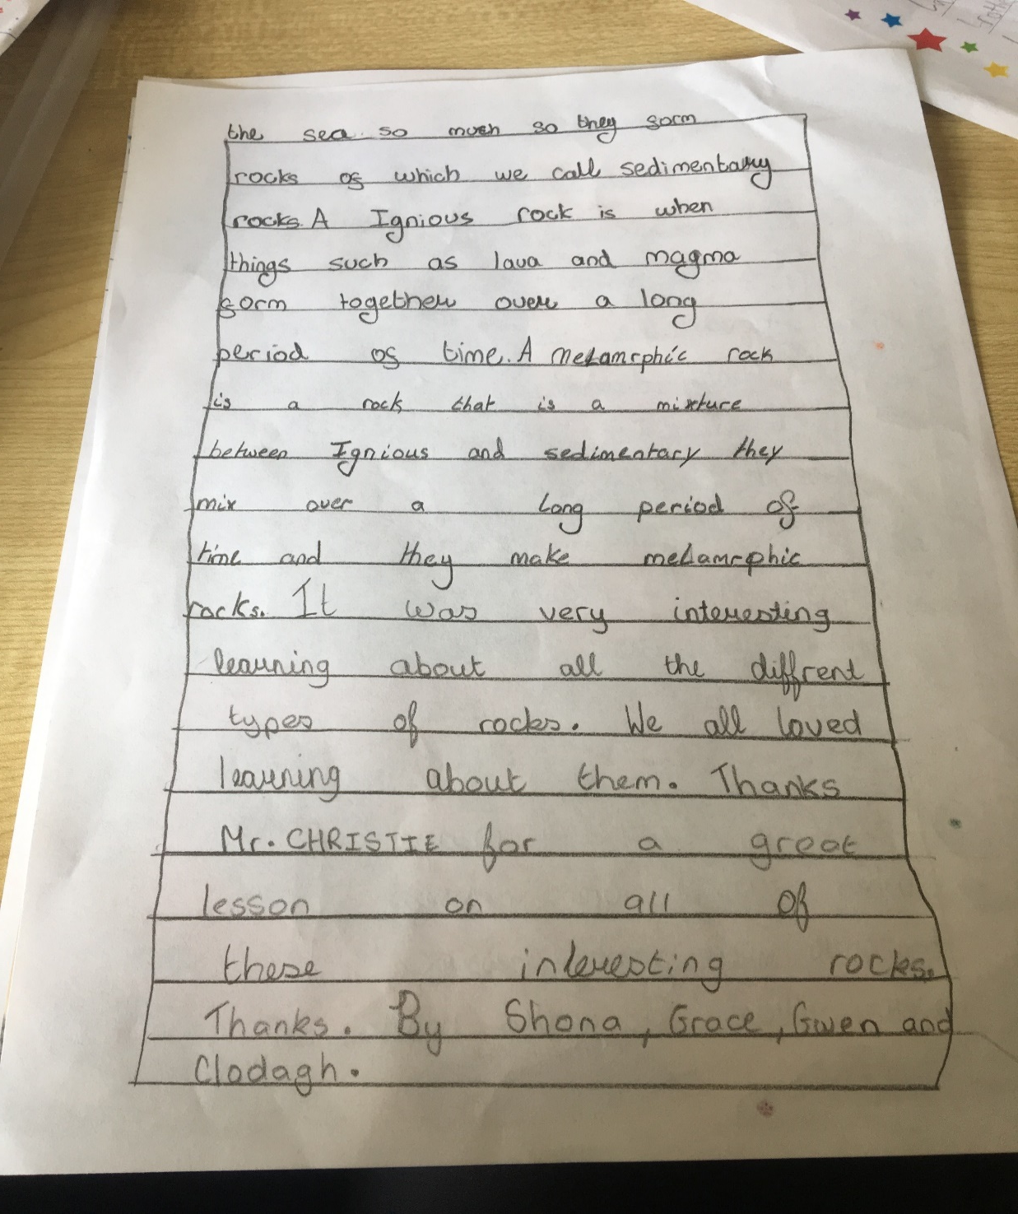

Slide 14
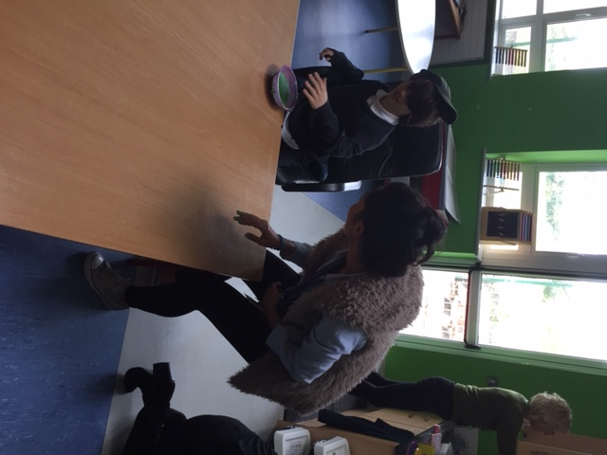
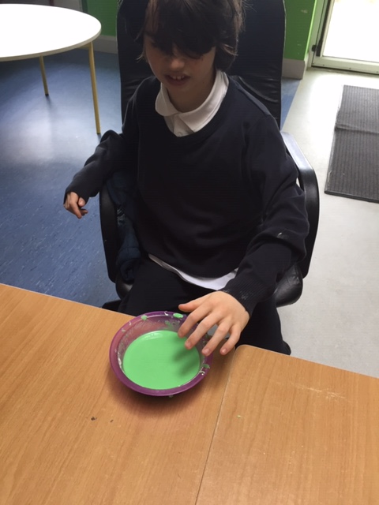
Materials – making oobleck
Ana’s class made this special material for science week called oobleck and went around all the classes displaying it

Slide 15
Materials – the science of popcorn 3rd/4th

Slide 16
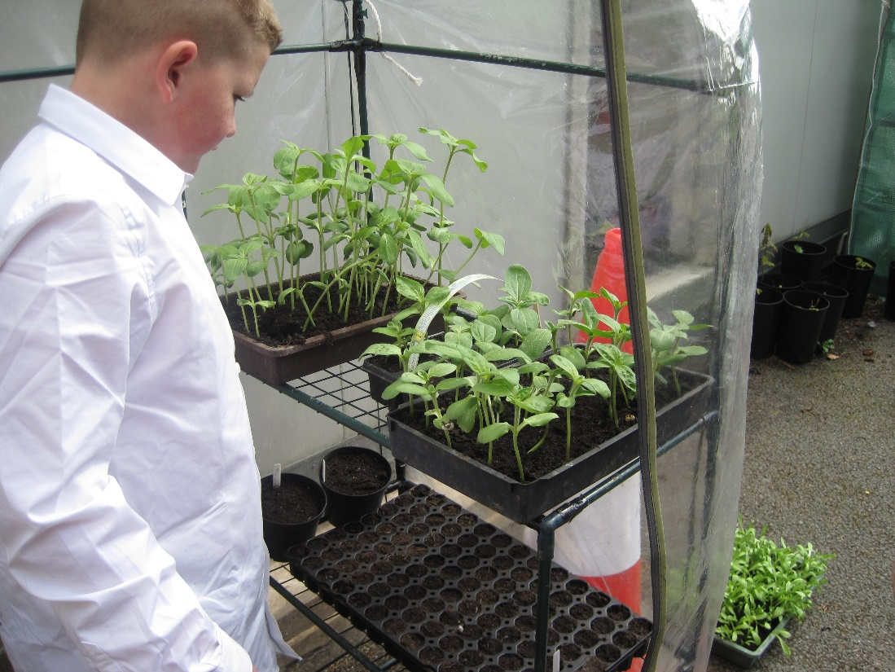
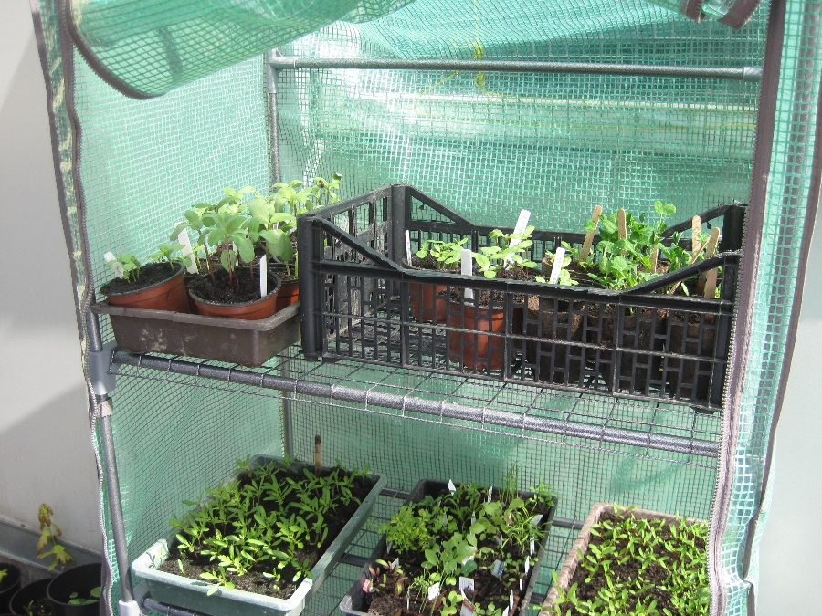
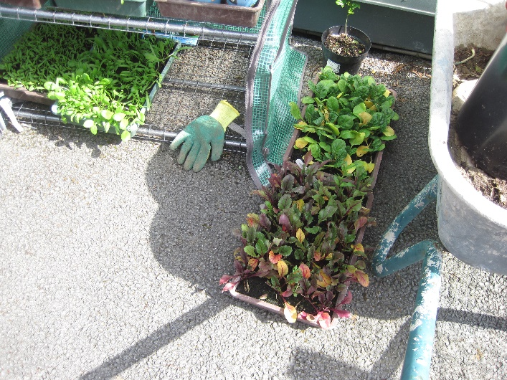
Environmental awareness and care
Valerie’s class made bird feeders from recycled plastic bottles
We took part in the incredible edibles project and planted potatoes
We planted different varieties of sunflowers

Slide 17
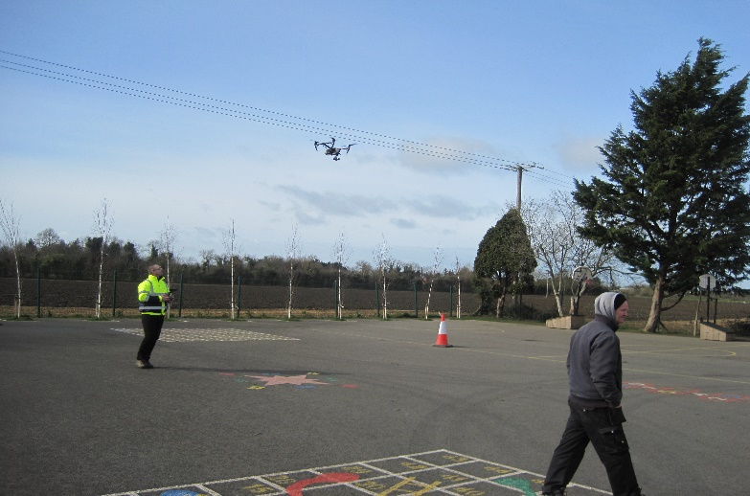
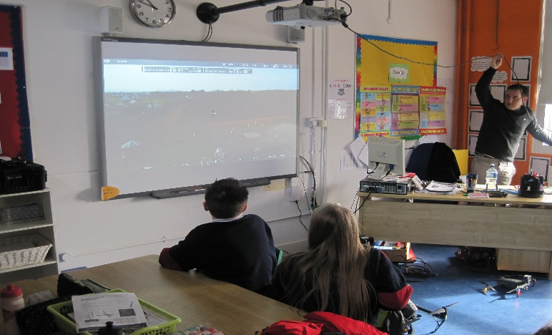
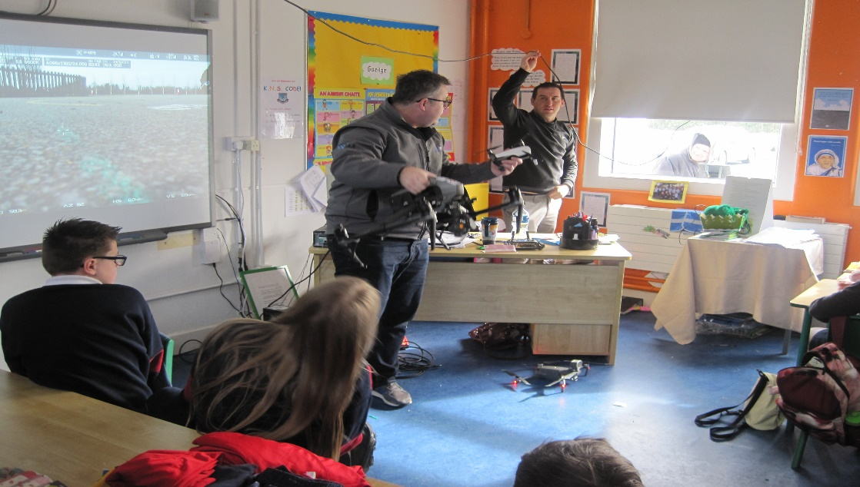
Invite a science speaker to your school Engineer visit from Glenveigh to talk about drones and do a display for the whole school

Slide 18
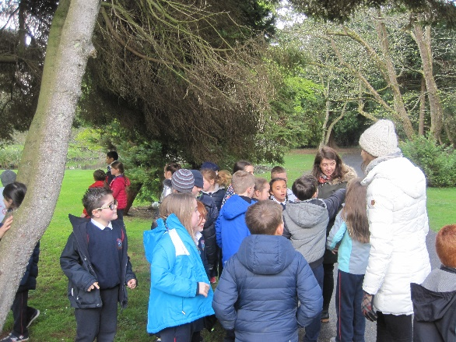
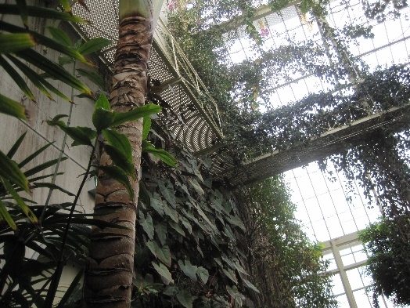
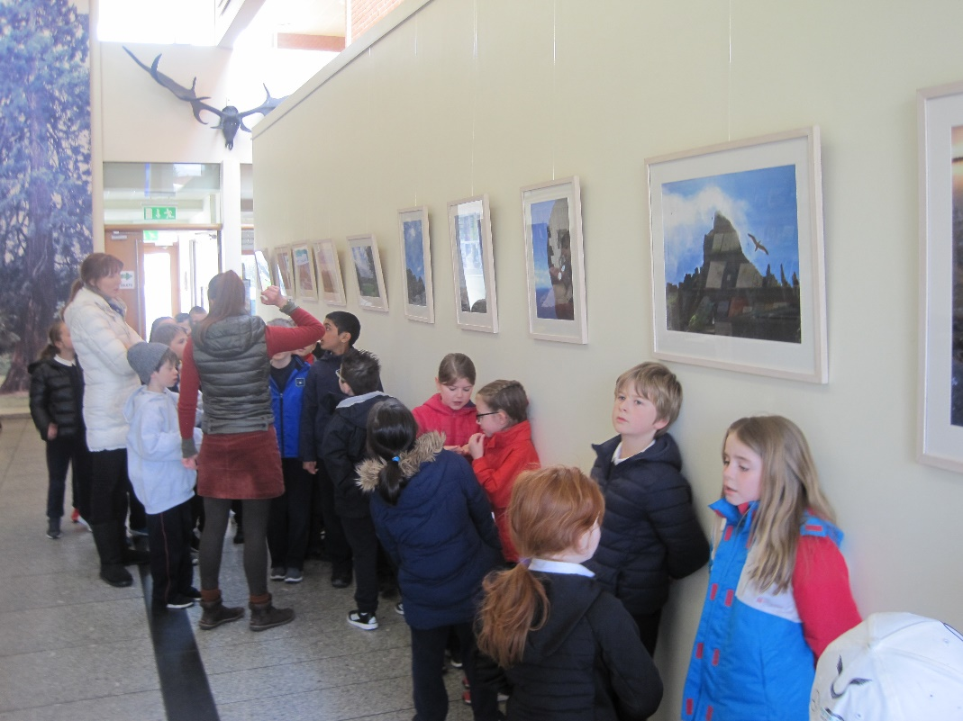
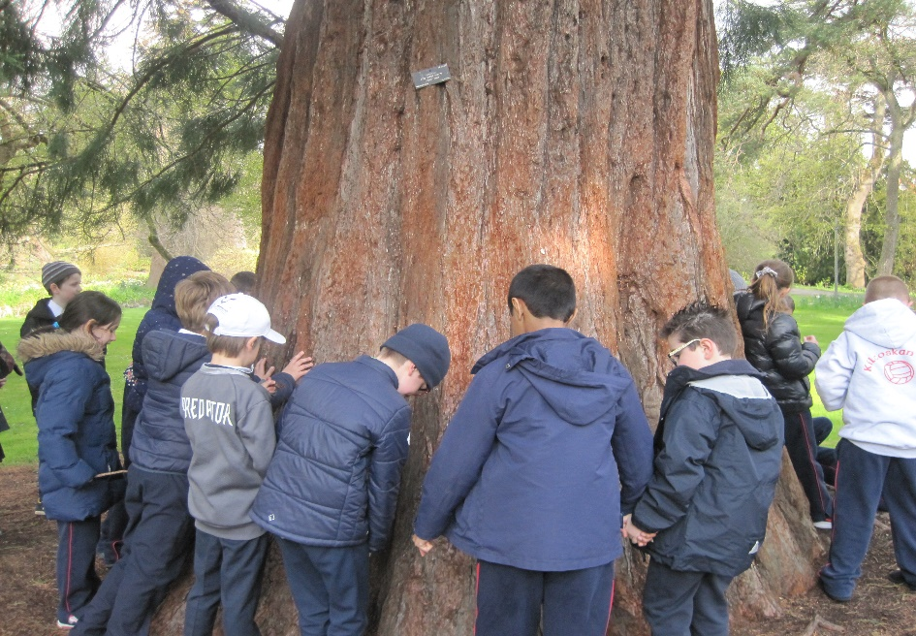
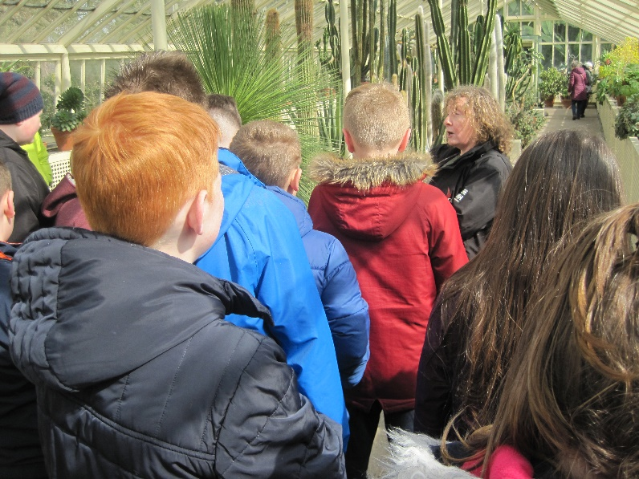
Visit an SFI Discover Centre
Trip to the Botanic Gardens for National Tree Week Thurs 4th April
1st/2nd/5th/6th

Slide 19
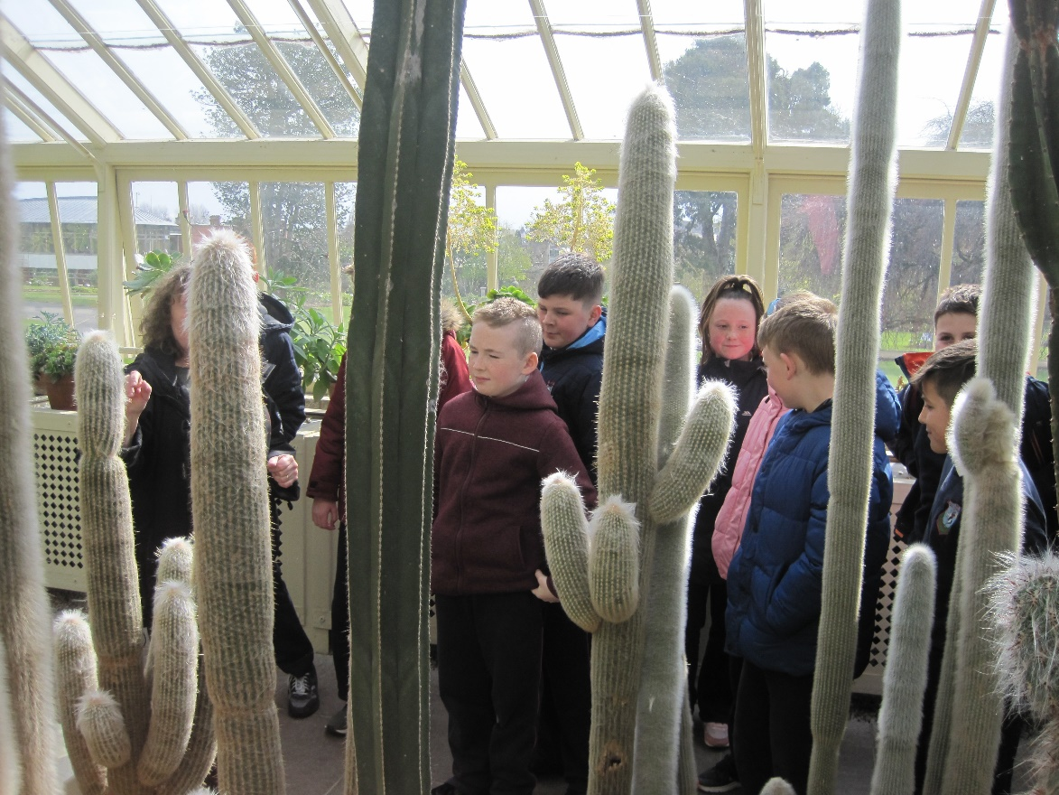
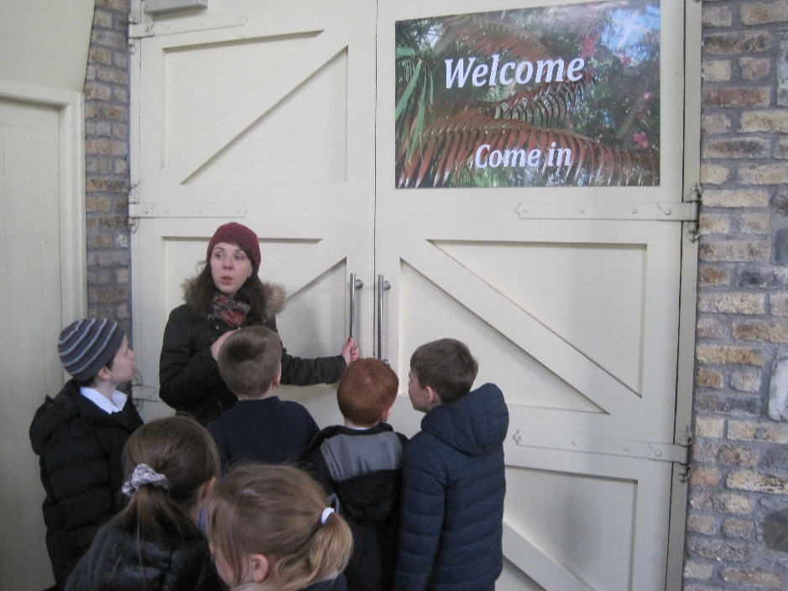

Slide 21
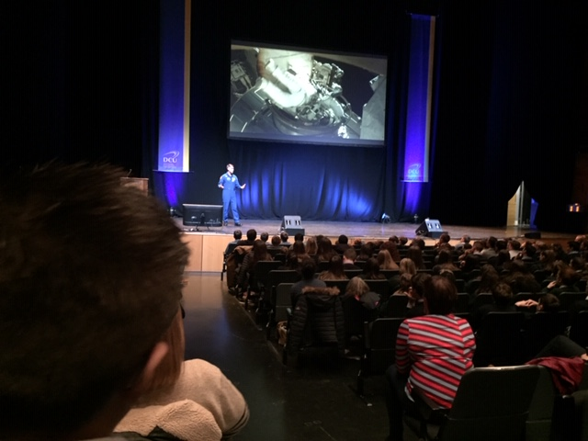
Take part in Science Week 2018
4th,5th and 6th went to the Helix in DCU to see a real astronaut for science week

Slide 22
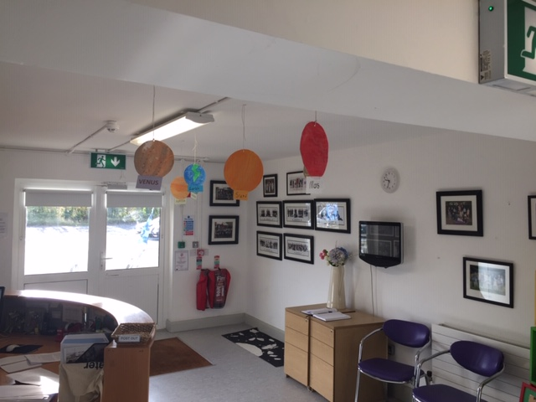
Take part in Space Week 2018
1st-6th did a project on the solar system
3rd-6th used an application on the ipads called SkyView (lite) to discover the position of the planets in the night sky

Slide 23
Solar system investigation sheet

Slide 24
STEP 2 Technology
Pupils in 3rd -6th used ipads to do a mentimeter survey on yard equipment

Slide 25
Pupils in 5th / 6th did a project on microscopes, went to the DCU physics labs to use some of them

Slide 26
Trip to Google to learn about programming and computing

Slide 27
Registered for scratch programming for Tech week , hourofcode on 15th May

Slide 28
STEP 3 Engineering
Investigate engineering in your area , 1st-6th went on a tour to Glanmore Foods in Ballycoolin Ind Estate to learn about how the school lunches are made

Slide 29
Glanmore Factory

Slide 30
Spaghetti bridges were made by 1st/2nd /3rd/4th
https://www.kilcoskanns.ie/news/engineering-week-/

Slide 31
Engineering a bird’s nest!!
https://www.kilcoskanns.ie/news/nest-building-time/

Slide 32
3rd/4th attended an engineering week event in Marsh’s library
https://www.kilcoskanns.ie/news/engineering-week-/

Slide 33
STEP 4 Maths
4th/5th/6th attended a maths show in the Helix for maths week

Slide 35
Graph of bounceability of a ball !!

Slide 36
We made clinometers to measure the height of the tree in our garden

Slide 37
Children used maths skills for gardening , capacity of containers for watering plants and measuring distances/lengths for construction of the canopies

Slide 38
(Continued)

Slide 39
STEP 5 STEM Show and Tell
Pupils in 5th/6th came around during science week ( Nov 2018 ) to the Jun/Sen infants and 1st/2nd to do a science show based around some of the science they had done in their own class in September / October
https://www.kilcoskanns.ie/news/science-week-fun-/

Slide 40
We really enjoyed our work on STEM this year Thank you .

